Slide 1

HDR Video Reconstruction
Review 3: Project Presentation
EE5176 Project
Shital (EE20S052) | Rahul (EE20S136) | Shrisudhan (ME17B122)

Slide 2
Overall Problem Statement
Implementing an algorithm to reconstruct High Dynamic Range(HDR) video from coded exposure frames designed by exploiting temporal and spatial information from the video frames.
Task-3 Problem Statement
Generate coded exposure frames by exploiting temporal information from the previous frames and get proper tonemapped output.
Implement idea of losing temporal resolution to improve spatial resolution.
HDR reconstruction using DNN

Slide 3
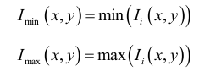
LDR Image Generation - Algorithm
The generation of the LDR images with various exposures from a single HDR image can be improved by considering chrominance values.
From the input HDR image, I, we separate the chrominance value (cb, cr) using the rgb2ycbcr function. Create the minimum channel value image and maximum channel value image.
We take the chrominance value of I and use I_{min} as luminance to generate low exposure image and I_{max} to generate high exposure images.

Slide 4
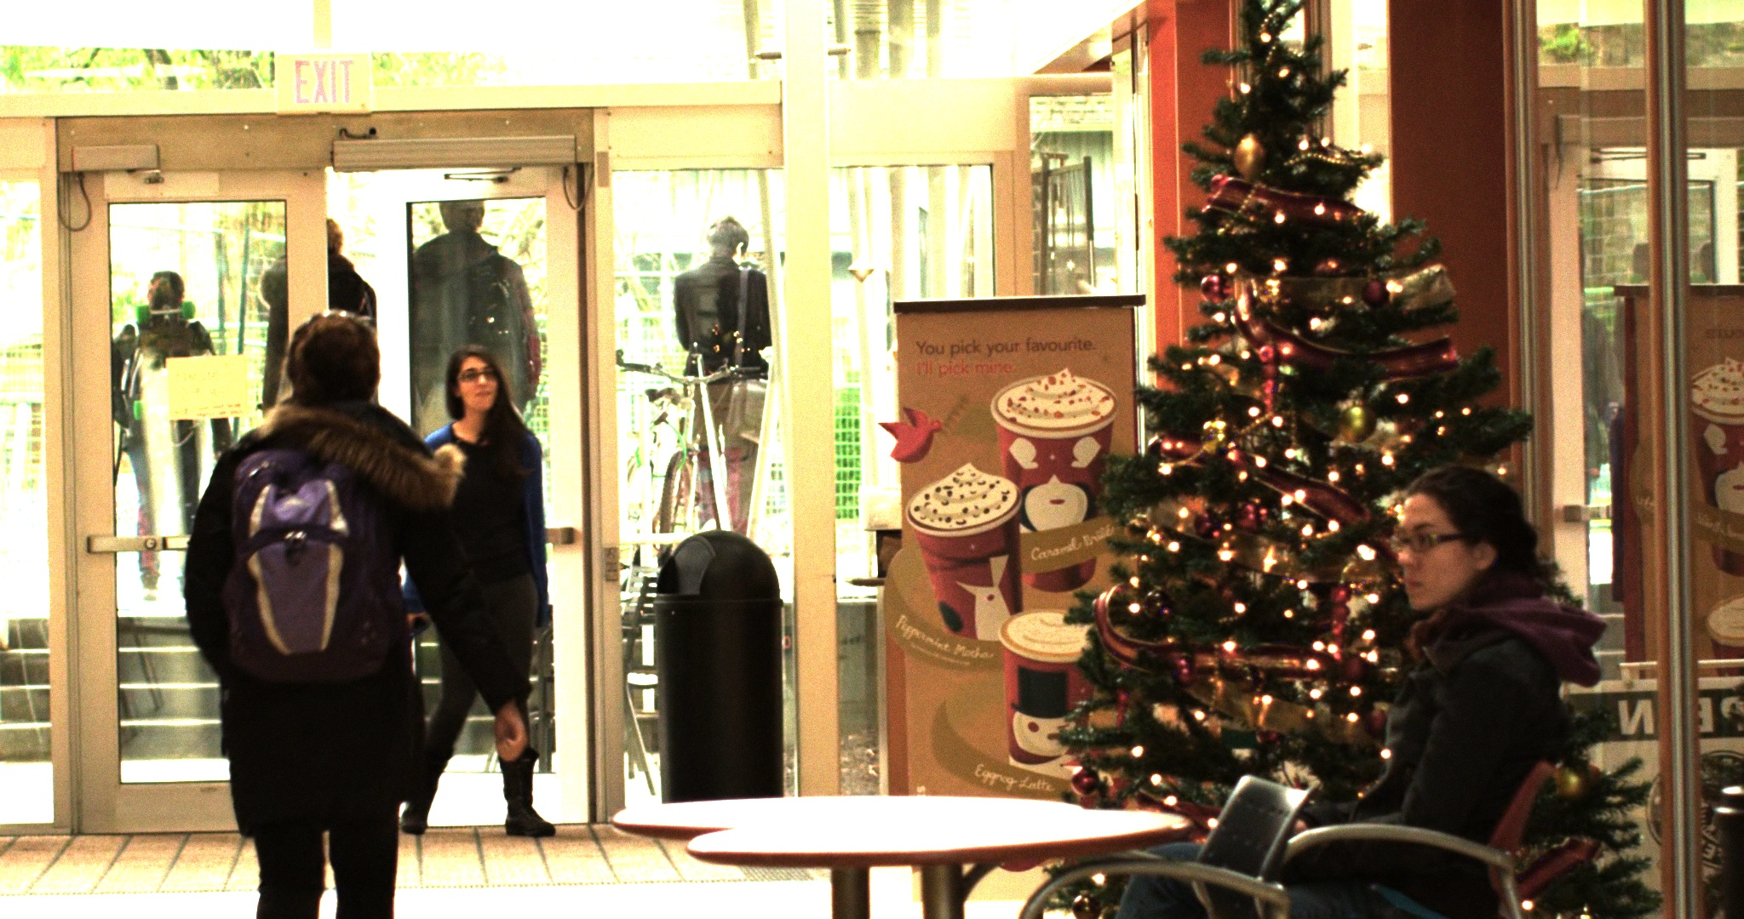
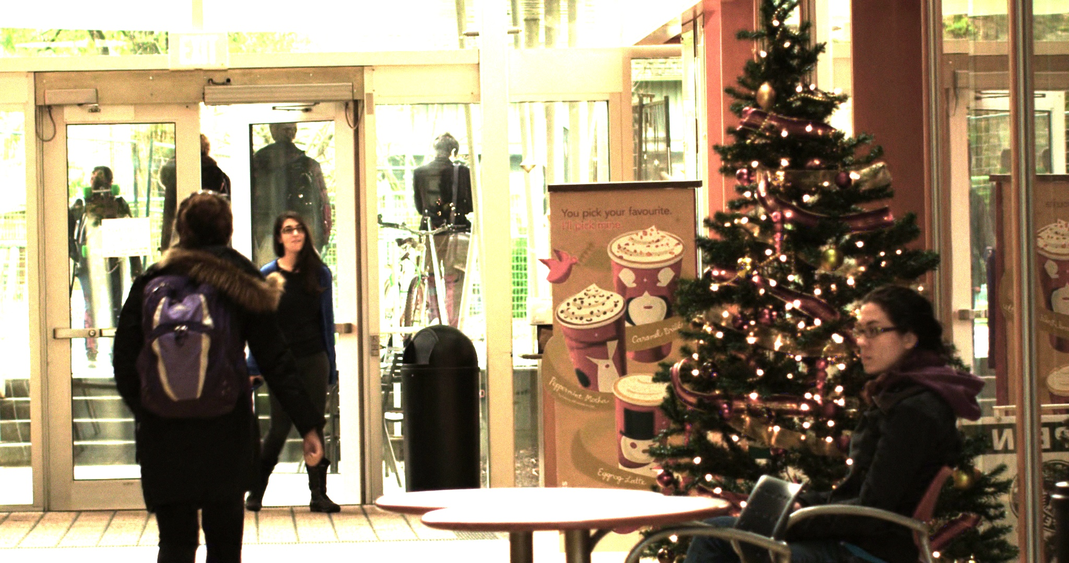
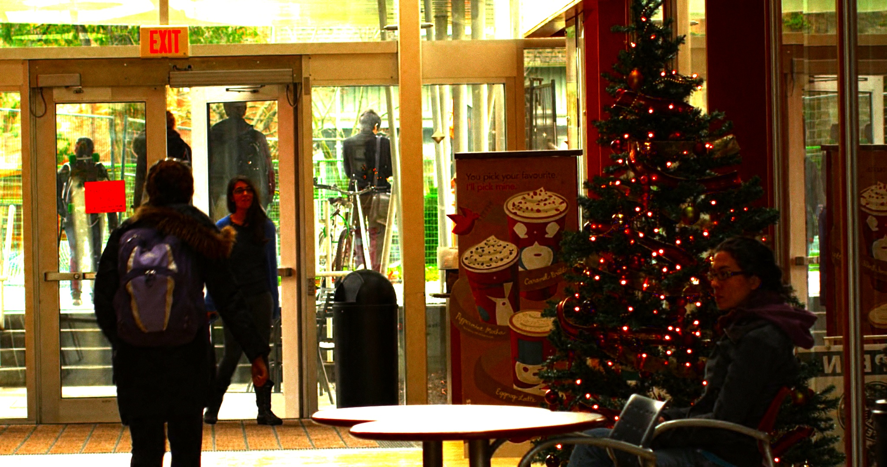
LDR Image Generation - Results
High exposure
High exposure
High exposure
Low exposure
Moderate exposure

Slide 5
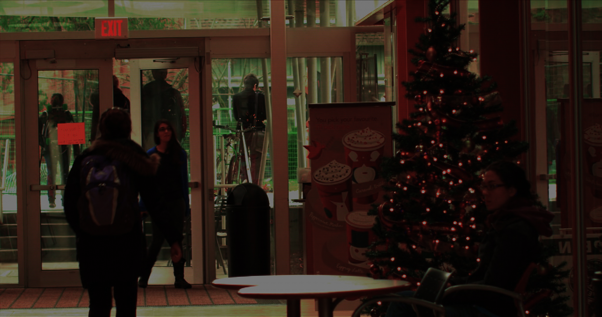
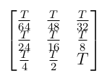
Coded Exposure Generation - Results

Slide 6
HDR Image Reconstruction with Super Resolution
In this method, exposure time for pixels are kept in a bayer like pattern. This is shown in the next slide. Once this image is obtained, rest of the process is
Extract 9 low-resolution images with equal exposures, corresponding to T/32, T/16 etc.
Combine the 9 LDR images into one HDR image using Debevic's algorithm.
This gives us a low-resolution reconstructed HDR image.
To get back to the full resolution, deep learning based super resolution algorithm is applied to the HDR image generated previously.
Fast Super-Resolution Convolutional Neural Network(FSRCNN) model is used to directly upsample the image.

Slide 7
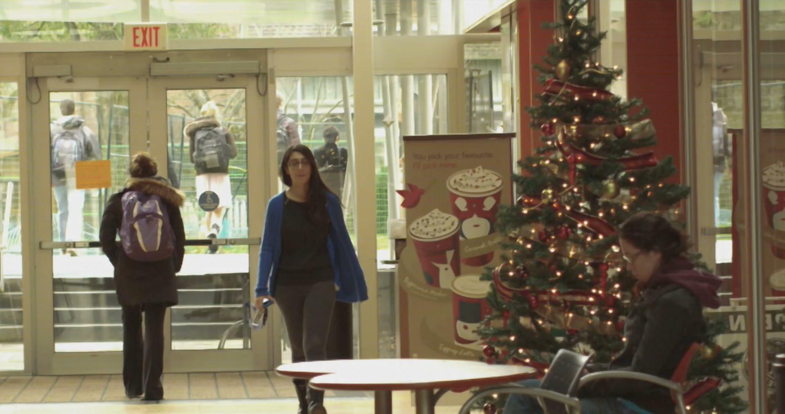
HDR Video Reconstruction with Super Resolution

Slide 8
Pixel-wise Adaptive Coded Exposure
In this method exposure times are set for each pixels individually.
Exposure time for each pixel is determined based on the intensity in the previous frame.
This is advantageous as in a single frame, a wide range of illumination could be achieved
Disadvantage is that high speed computation capability is required as for each pixel the exposure time for next frame should be determined before next frame capture begins.

Slide 9
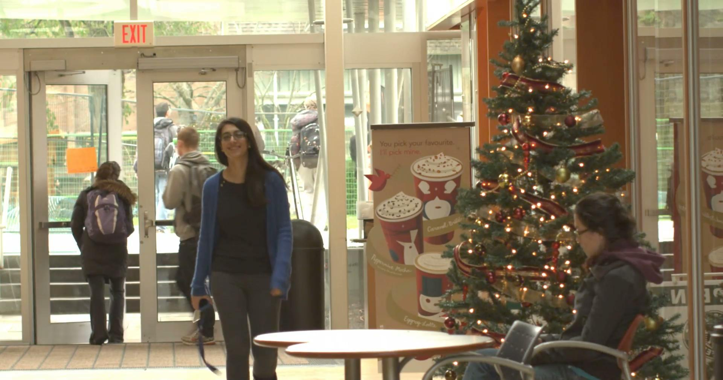
Pixel-wise Adaptive Coded Exposure

Slide 10
Cyclical pre-determined exposure times
Previously fixed bayer pattern and highly adaptive bayer patterns were tested.
In the former case, bayer-like fixed exposure time pattern was used for all the frames.
In later case based on the intensity in each pixel, exposure time was dynamically set for each pixel.
New exposure pattern was tested this time. In this case, the exposure time pattern was changed in a predetermined manner for each frame.
This is advantageous as for each pixel all the exposure times would have been applied.
In this method intensity is adjusted, then frames are aligned using optical flow.
Once the frames are aligned, Debevec HDR algorithm is used to merge them

Slide 11
Cyclical pre-determined exposure times
Pros:
For each pixel, different exposure times will be captured and hence for stationary parts of the scene different exposure times will be available for same pixel. This will help us improve the quality of HDR reconstruction
Cons:
For dynamic part of the scene, optical flow estimation and correction is required. The method of optical flow based alignment of frames has some issues.
Algorithms for reconstruction:
Farneback optical flow algorithm based reconstruction.
Beyond Pixels: Exploring new representations and applications for motion analysis(optical flow algorithms are added)

Slide 12
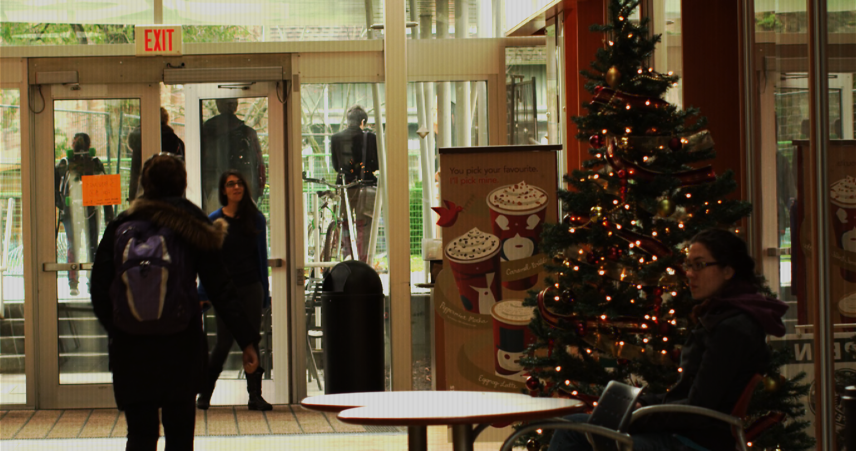
Cyclical pre-determined exposure times - Camera Output

Slide 13
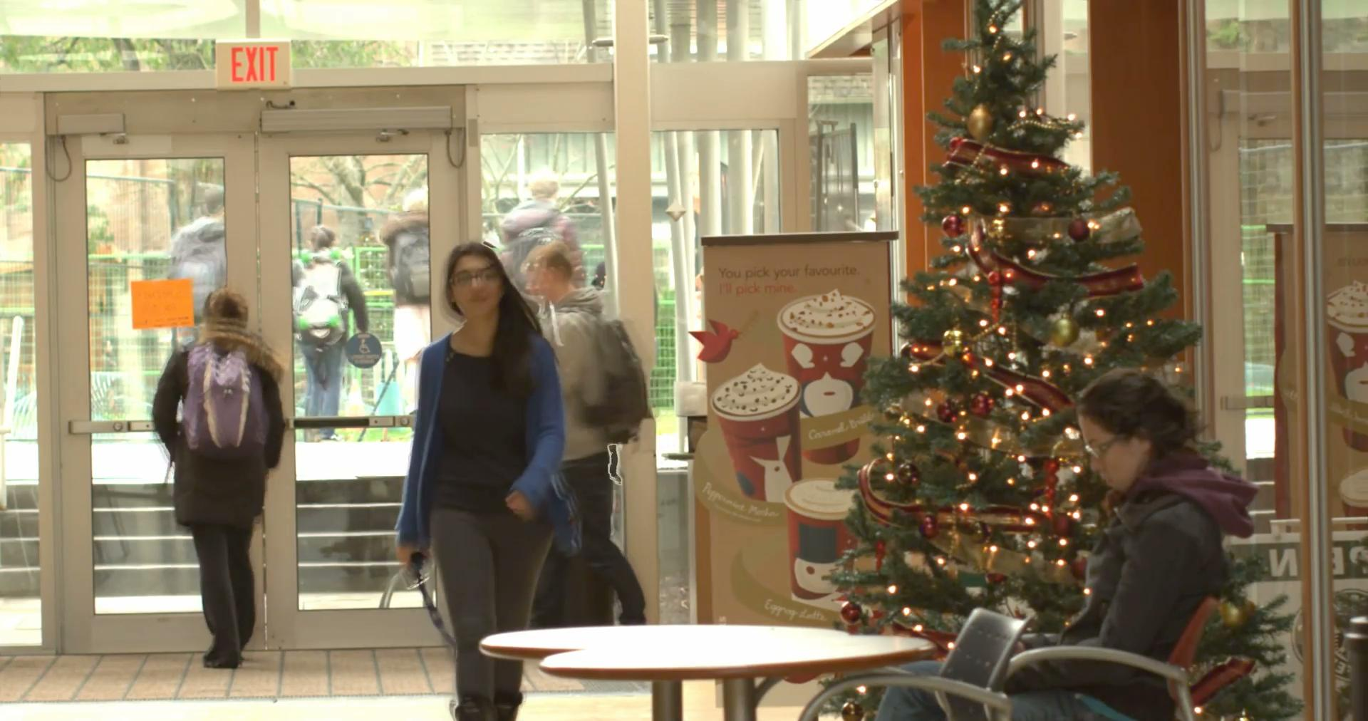
Farneback - HDR Reconstruction video results

Slide 14
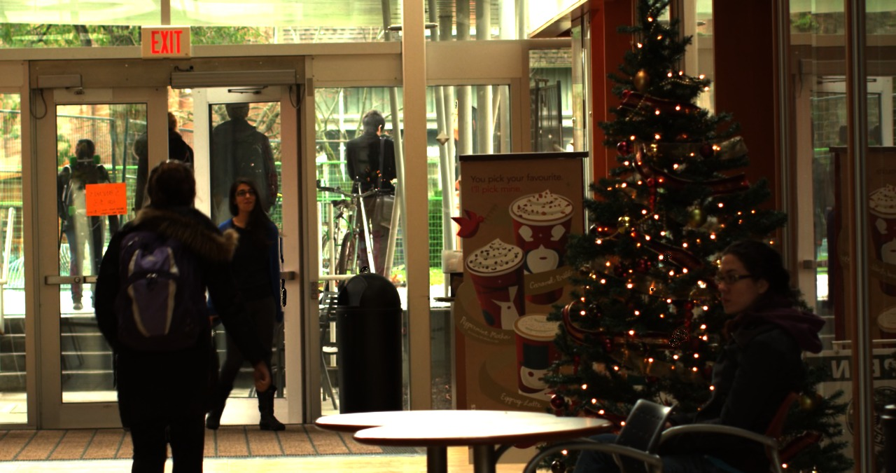
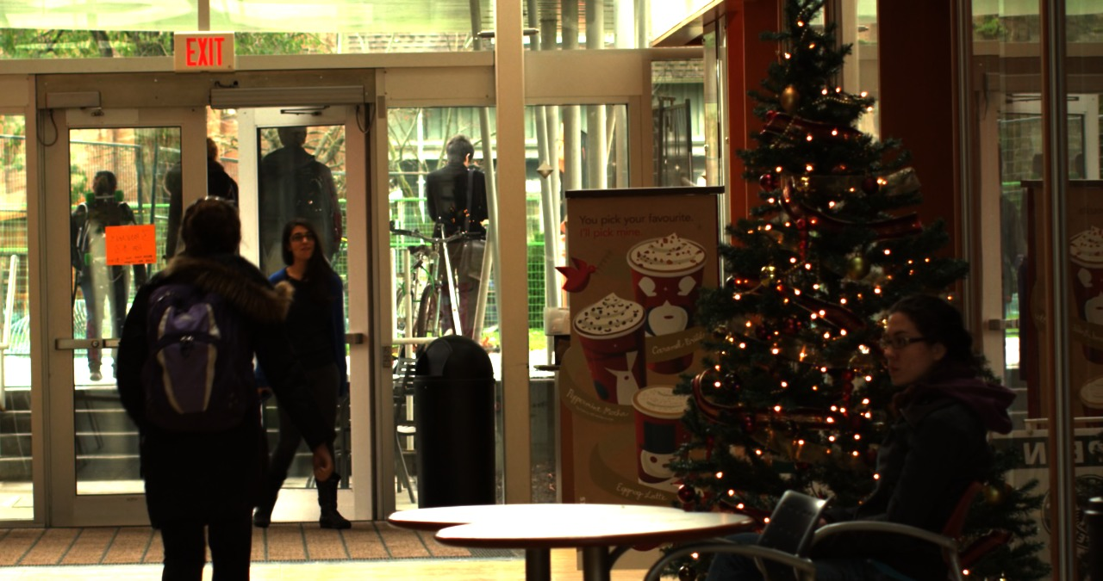
Beyond Pixel paper algorithm
Warped Frame
Target Frame
This method takes around 41 seconds for finishing 1 optical flow computation. To process 1 frame 2 optical flow computation is required, hence it takes around 1.5 minutes for a frame.

Slide 15
Summary
Pixel adaptive decoding provides better results but requires high speed computation capabilities to adjust exposure time for each pixel in next frame in a real time manner.
Compromising spatial resolution i.e. using super-resolution also provides better results. Here ghosting effect won’t come into picture but spatial resolution is lost.
Compromising on temporal resolution doesn’t seem to be a good idea, since for dynamic scenes optical flow based alignment of frames is required which is challenging in nature.

Slide 16
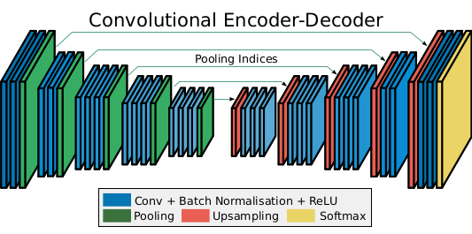
HDR Video Reconstruction using DNN
An encoder-decoder based network can be trained to reconstruct HDR frames from Coded Exposure frames given as inputs.
The SegNet model uses skipped connection between pooling and unpooling layers to avoid information loss in the unpooling layer.
A variation on SegNet with skipped connections and TSM module will be implemented.
SegNet

Slide 17
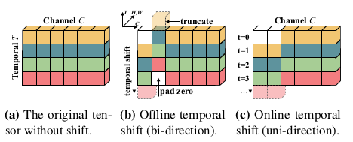
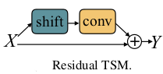
HDR Video Reconstruction using DNN
As observed in the Pixel-wise Adaptive Coded Exposure image, the estimation of movement of objects between consecutive frames would improve reconstruction performance.
The temporal information between frames can be combined using a Temporal Shift Module(TSM) which can be added with residual skip connections in the encoder network.

Slide 18
HDR Video Reconstruction using DNN
Overall Network architecture: ResNet-50 backbone with TSM layers
TSM Blocks

Slide 19
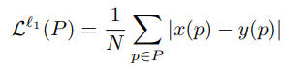
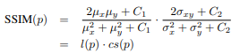
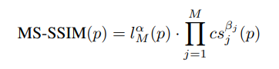
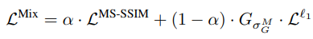
HDR Video Reconstruction using DNN
Loss Function:
L1 Loss: Used to retain high frequency features
SSIM Loss: Used to retain low frequency features
MS-SSIM Loss: Considers multiple gaussian kernels
Mixed loss: Best of both losses

Slide 20
HDR Video Reconstruction using DNN - Training
The dataset consists of 5000 HDR video frames from 16 different scenes obtained from DML-HDR dataset. Each image is of resolution 2048x1080 pixels.
LDR and Coded Alternating Exposure frames are prepared.
Due to the high spatial resolution of the input frame, the input to the network is 10 random patches of 224x224 pixels from each frame, producing sufficient number of frames for training and also reducing memory requirement.
During evaluation, the image is split into 32 patches of 224x224 input and HDR images are reconstructed.
The network is trained for 30 epochs to achieve convergence.

Slide 21

HDR Video Reconstruction using DNN - Results

Slide 22
HDR Video Reconstruction with DNN - Future Work
The used of DNN helps in maintaining spatial information even when trained with patches.
Networks for larger input sizes could be trained with larger datasets.
The network faces temporal inconsistency when there is large movements in specific parts of the frame.
Use of the whole image as input rather than patches will also enable better temporal consistency between successive frames.
Temporally consistency of the output can be improved by using explicit losses to maintain temporal continuity.

Slide 23
Individual Contributions - Task 3
Shital Sheshrao Yelne
Code development for Pixel wise adaptive coded exposure.
Code development for trying losing temporal resolution to improve spatial resolution(Cyclical predetermined optical flow)
Rahul G S
Code development for Pixel wise adaptive coded exposure.
Code development for trying losing temporal resolution to improve spatial resolution(Cyclical predetermined optical flow)
Shrisudhan G
HDR reconstruction using DNN

Slide 24
THANK
YOU

